Slide 1


INDIAN CARGO SHIPMENT

Slide 2
About Cargo Shipment
A cargo ship or freighter is a merchant ship that carries cargo, goods, and materials from one port to another
Shipping is the transport of cargo as a business, especially on ships.
The definition of cargo means items that are carried in a ship, train, truck, plane, etc

Slide 3
Units in Our Project
Branch Details By - Andleeb Nemat
Delivery Status & Delivery Master By – Mahammad Sharooq
Cargo Shipment By - Mohammad Mukthar
Client Details By – Aman Sahu

Slide 4
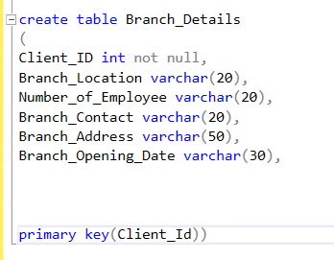
Create Table Query
Create table of Branch Details
-- > There are name of column
Client ID
Branch Location
Number of Employee
Branch Contact
Branch Address
Branch Opening Date

Slide 5
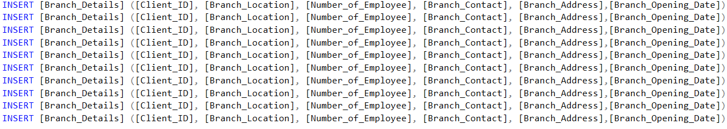
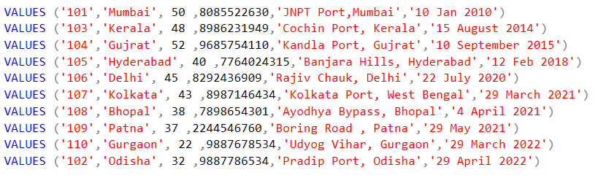
Insert Data and Values

Slide 6
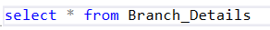
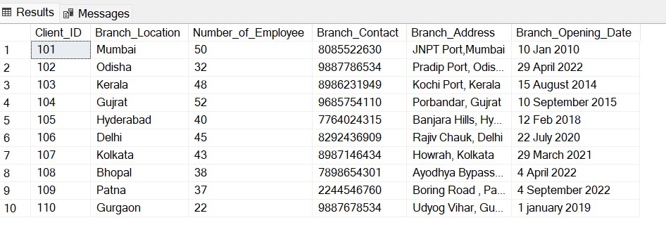
Select and Output

Slide 7
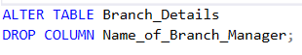
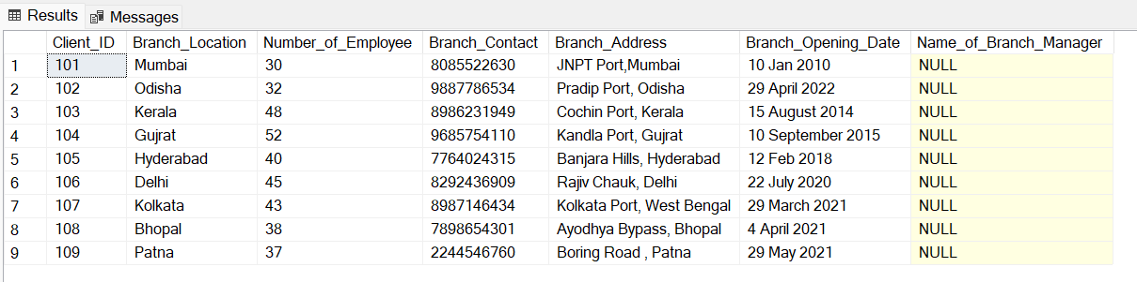
Alter & Drop Command

Slide 8
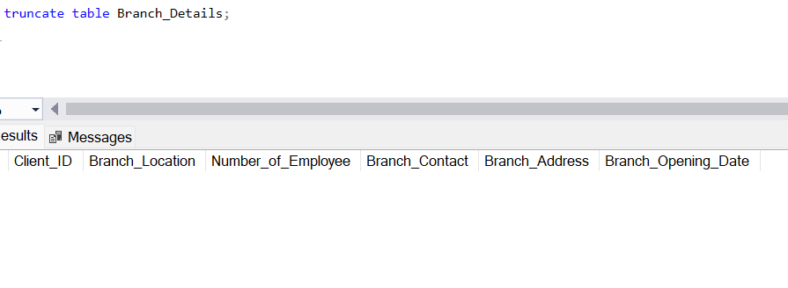
Truncate Command

Slide 9
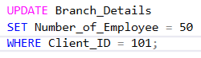
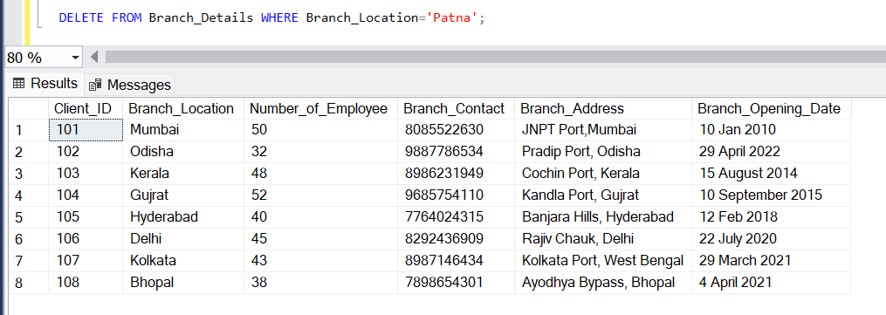
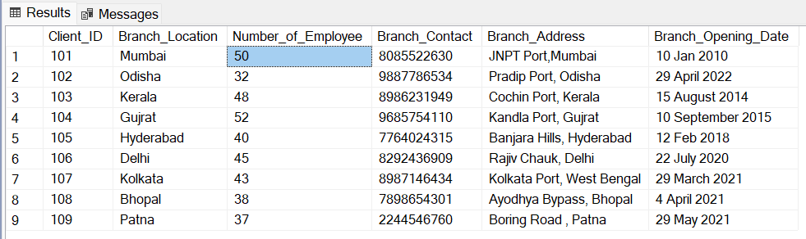
Update & Delete Command

Slide 10
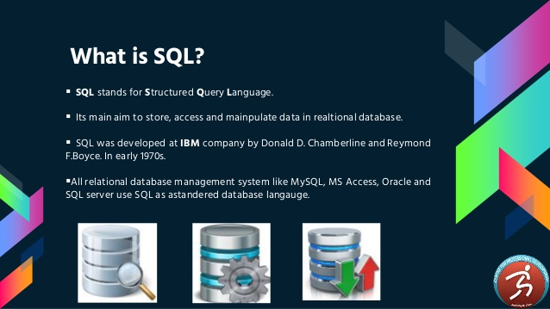

Slide 11
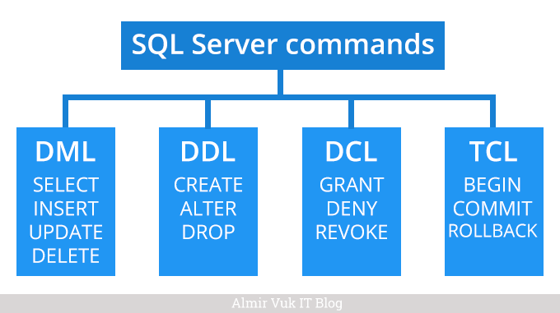
Types of SQL

Slide 12
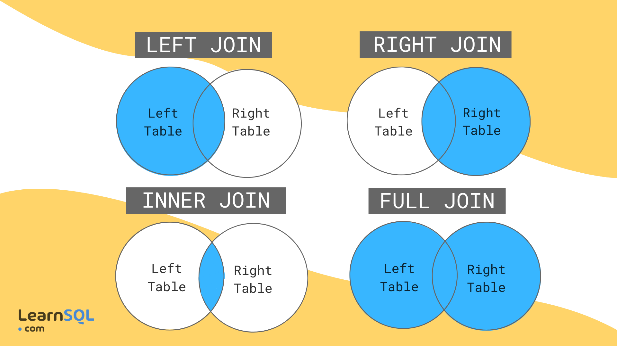
SQL JOINS

Slide 13
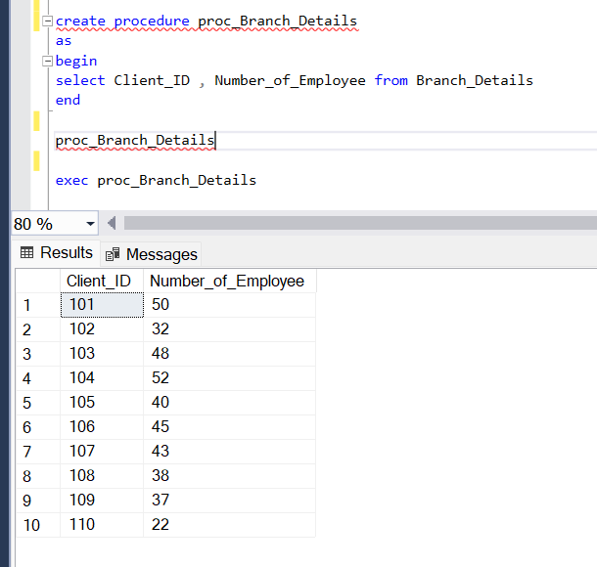
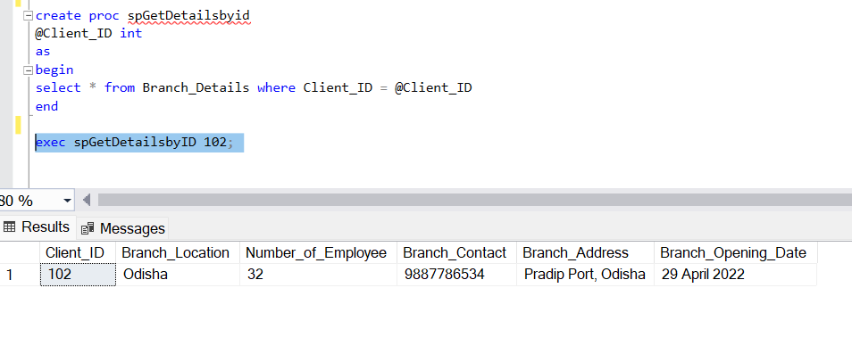
Procedure

Slide 14
Clustered index
A clustered index causes records to be Physically stored in a sorted or
sequential order
Clustered index is as same as dictionary where the data is arranged by
Alphabetical order
We can have only one clustered index in one table, but we can have
one clustered index on multiple column , and that type of index ix called
Composite index

Slide 15
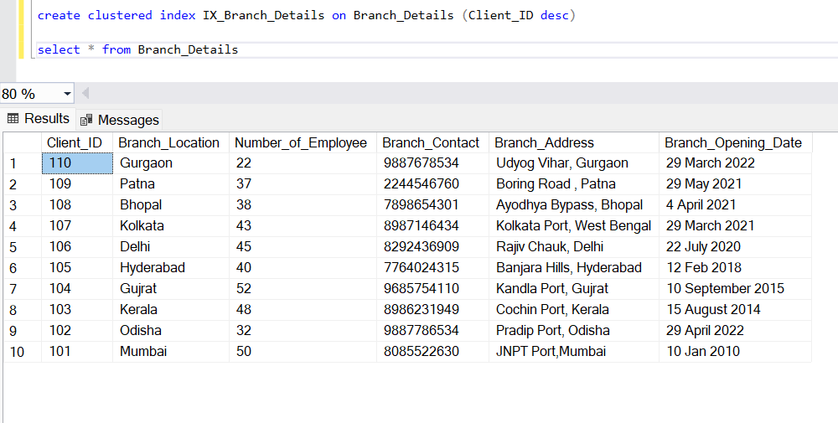
Clustered Index

Slide 16


